Slide 1
Bid-Hit
Web-Based Auction Platform

Slide 2
Developed by :-
Under the supervision of :-
Abhay Kumar
Ayush Singh
Om Narayan Shukla
Mr. Atul Uttam Sir (Assistant Professor, GLA University)

Slide 3

Introduction
It’s a website where the user can participate in auctions.
Users have to sign up on the website to participate in the auctions.
Auctions are available to bid for a certain period of time.

Slide 4
Sign Up Page
If the user is a new user, the he/she must have to sign up on this page.
After the registration, the data of new user will be updated on firebase.

Slide 5
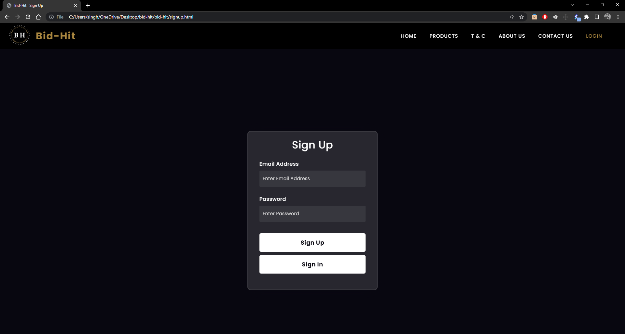

Slide 6
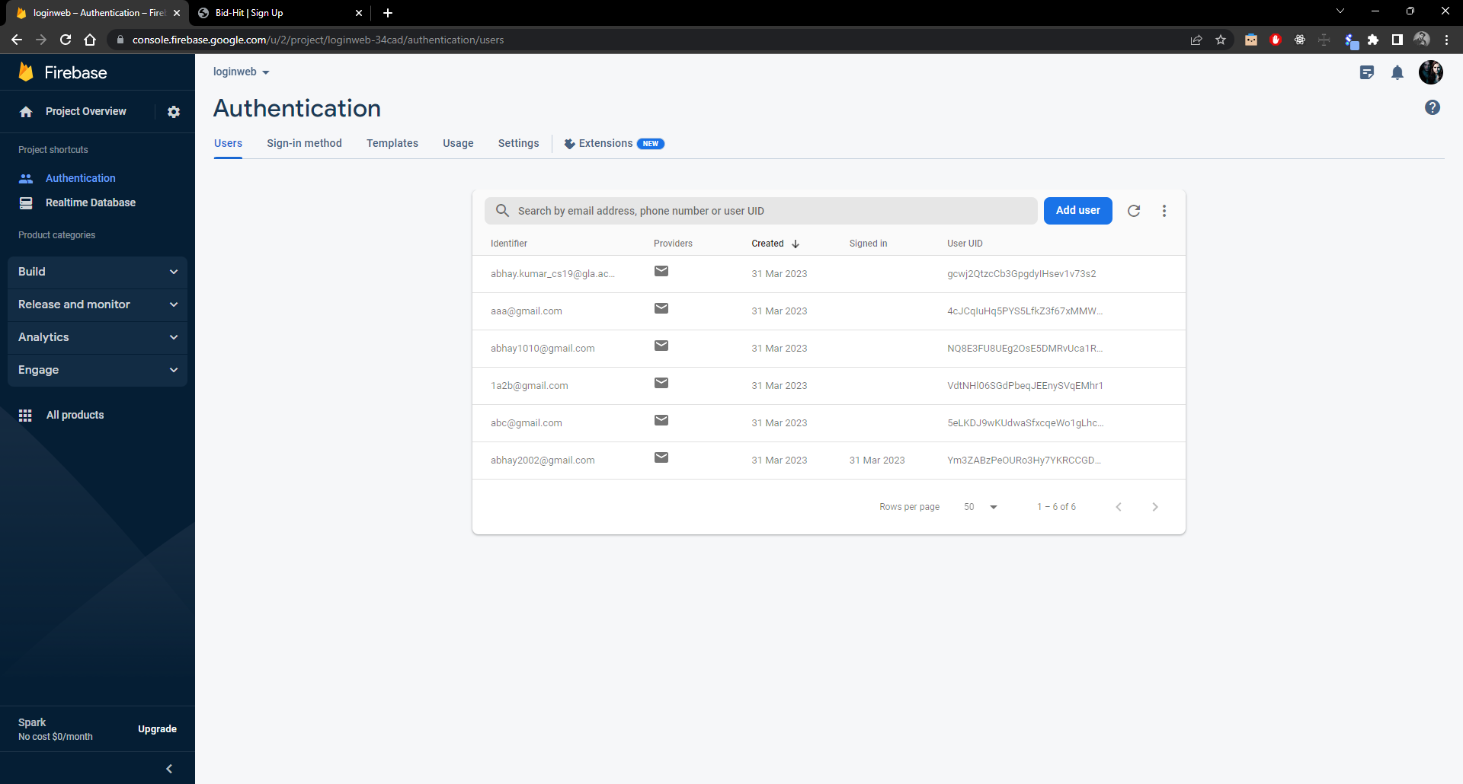

Slide 7
Sign In Page
If the user is a registered user, the he/she must have to sign in on this page
After successful sign in, the user will be redirected on the Home page.

Slide 8
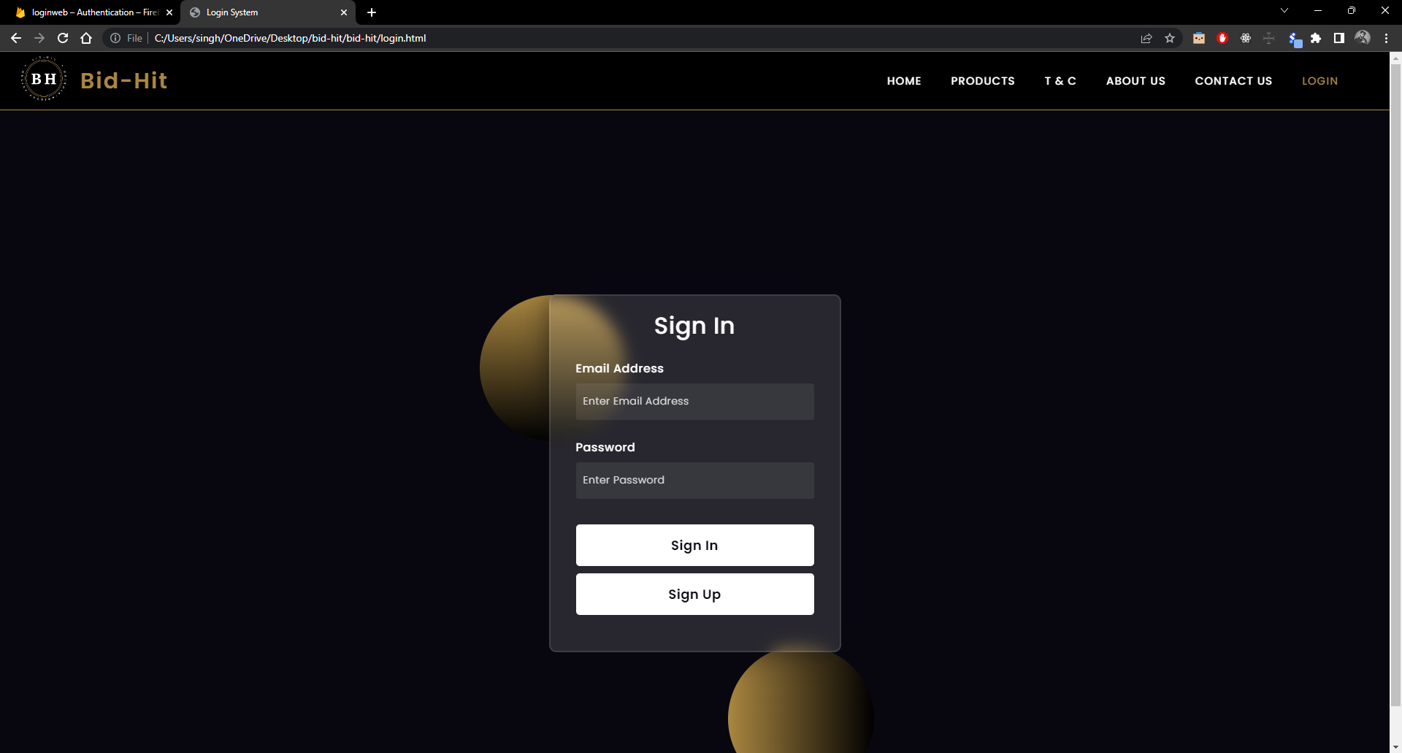

Slide 9
Home Page
On the Home page, the user will get many options on the navbar of the site. From where the user can go to different web pages.
And also on scrolling down, the user can subscribe on our site for latest updates. When the user will subscribe, his/her subscription detail will be stored on the firebase.
On clicking on “More Reviews” user can get the reviews from our customers.

Slide 10
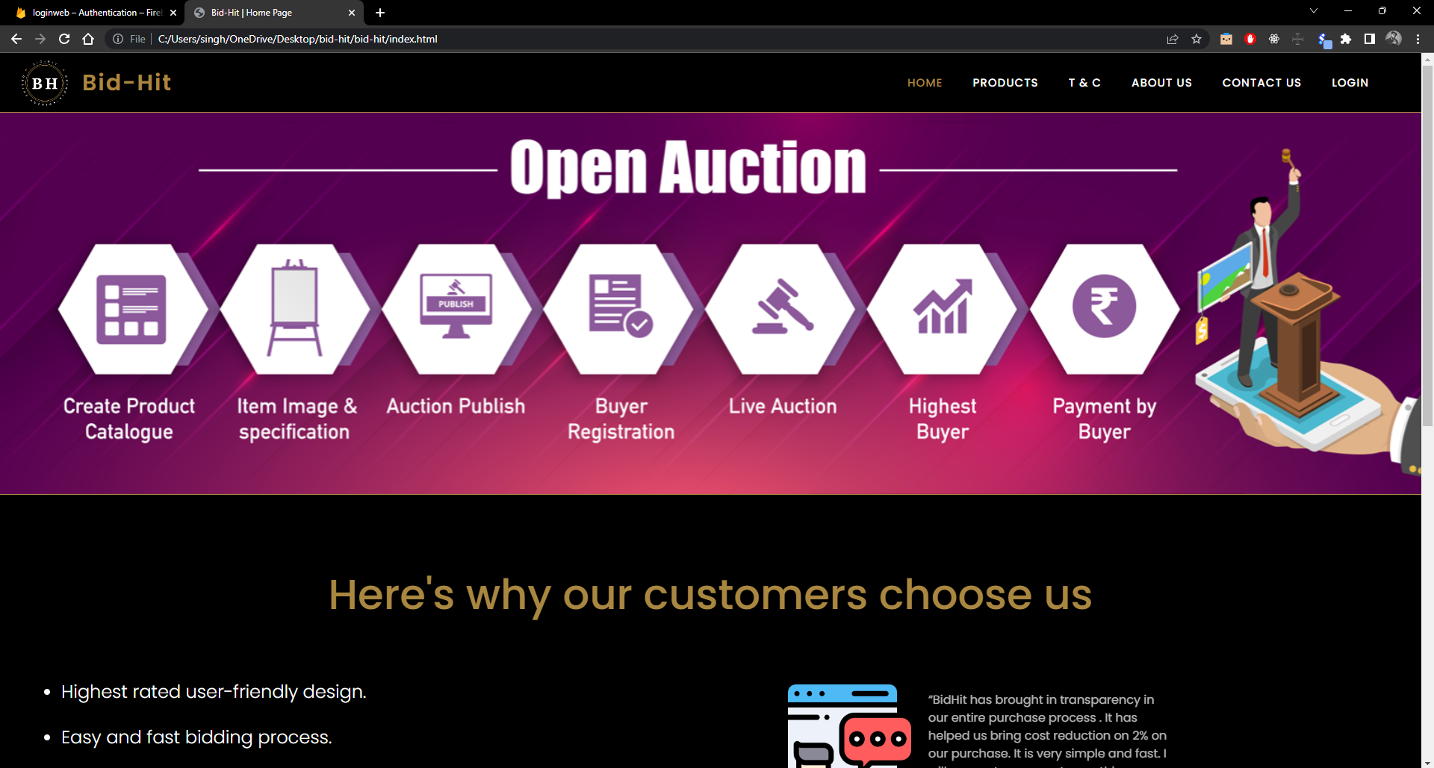

Slide 11
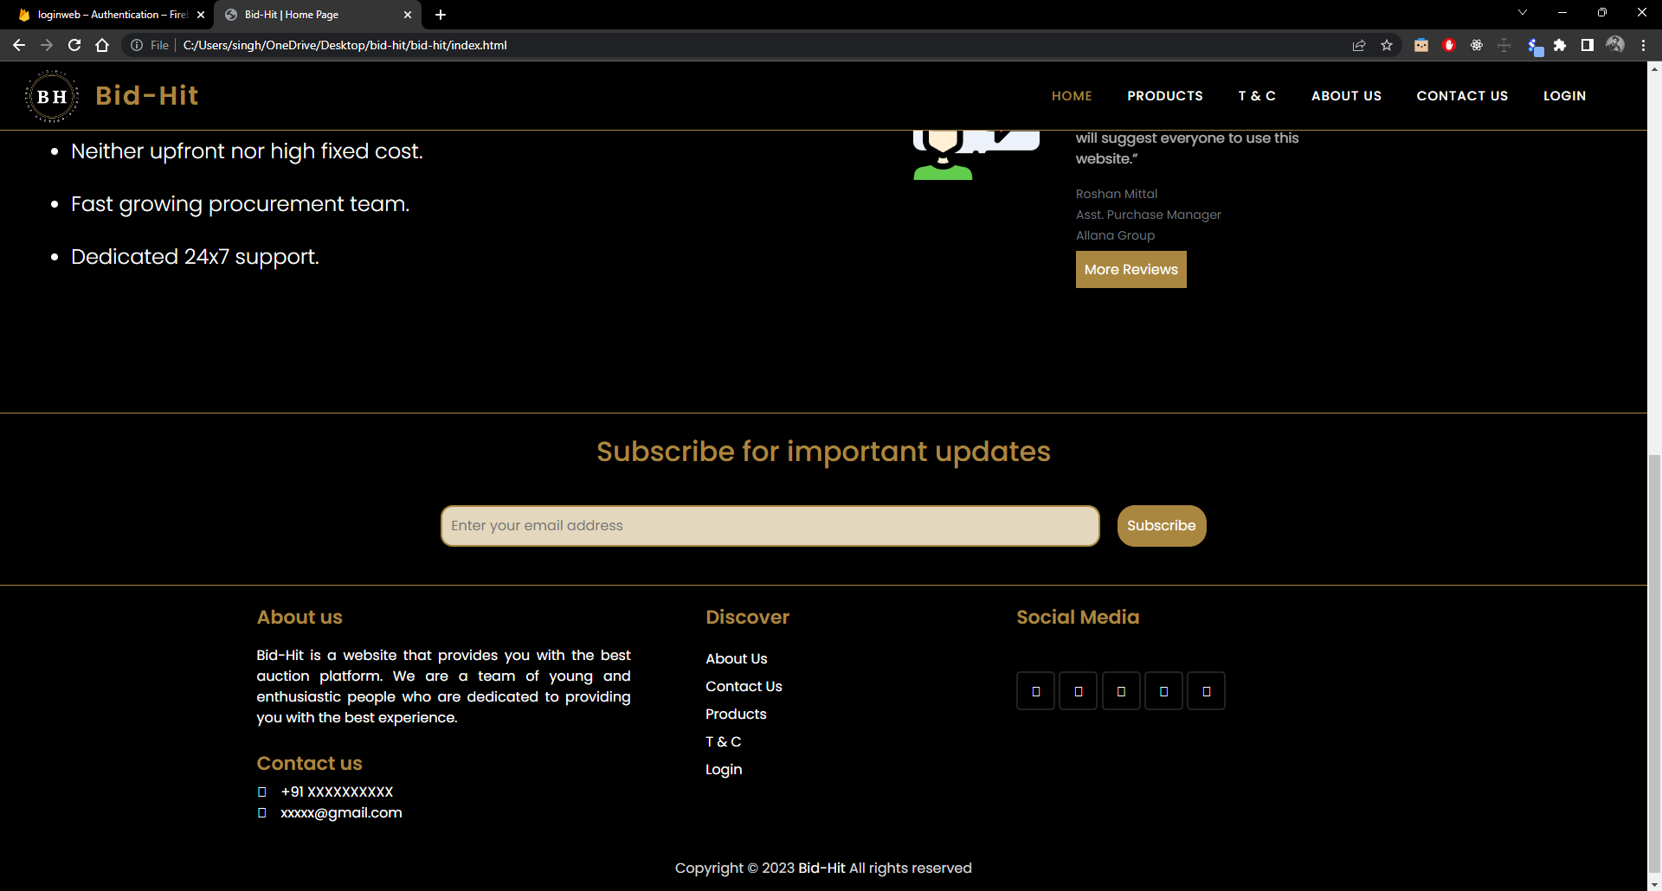

Slide 12
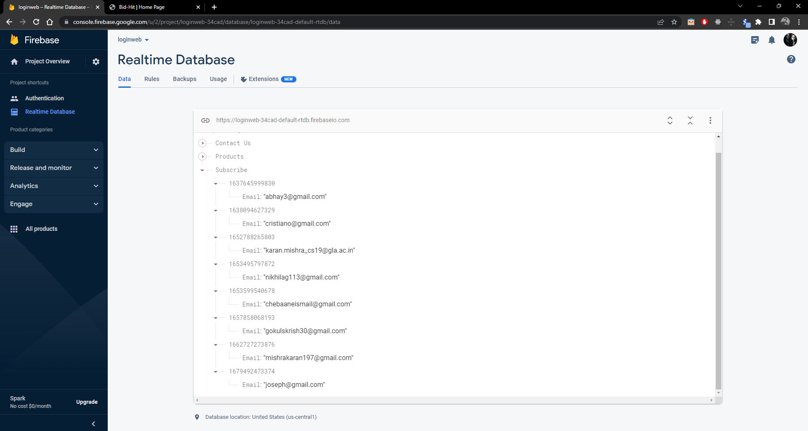

Slide 13
Terms & Conditions Page
Here the user can get all the terms and conditions for the bidding process, and many more.

Slide 14
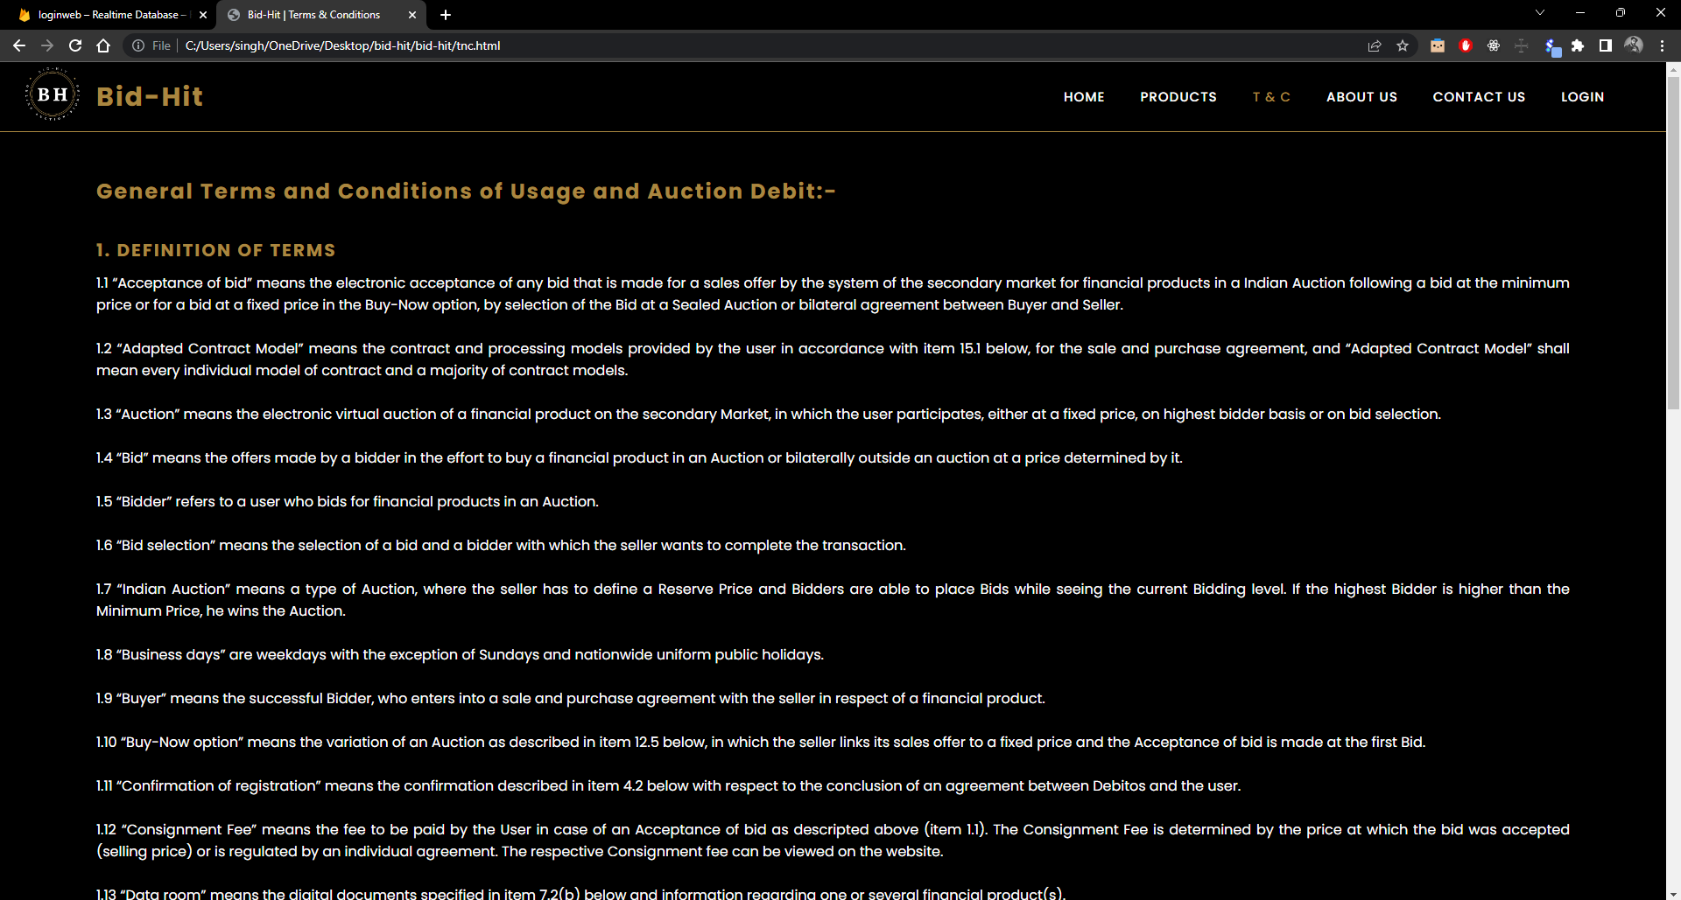

Slide 15
About Us Page
In this page, the user can get all the information about our website (Bid-Hit).

Slide 16
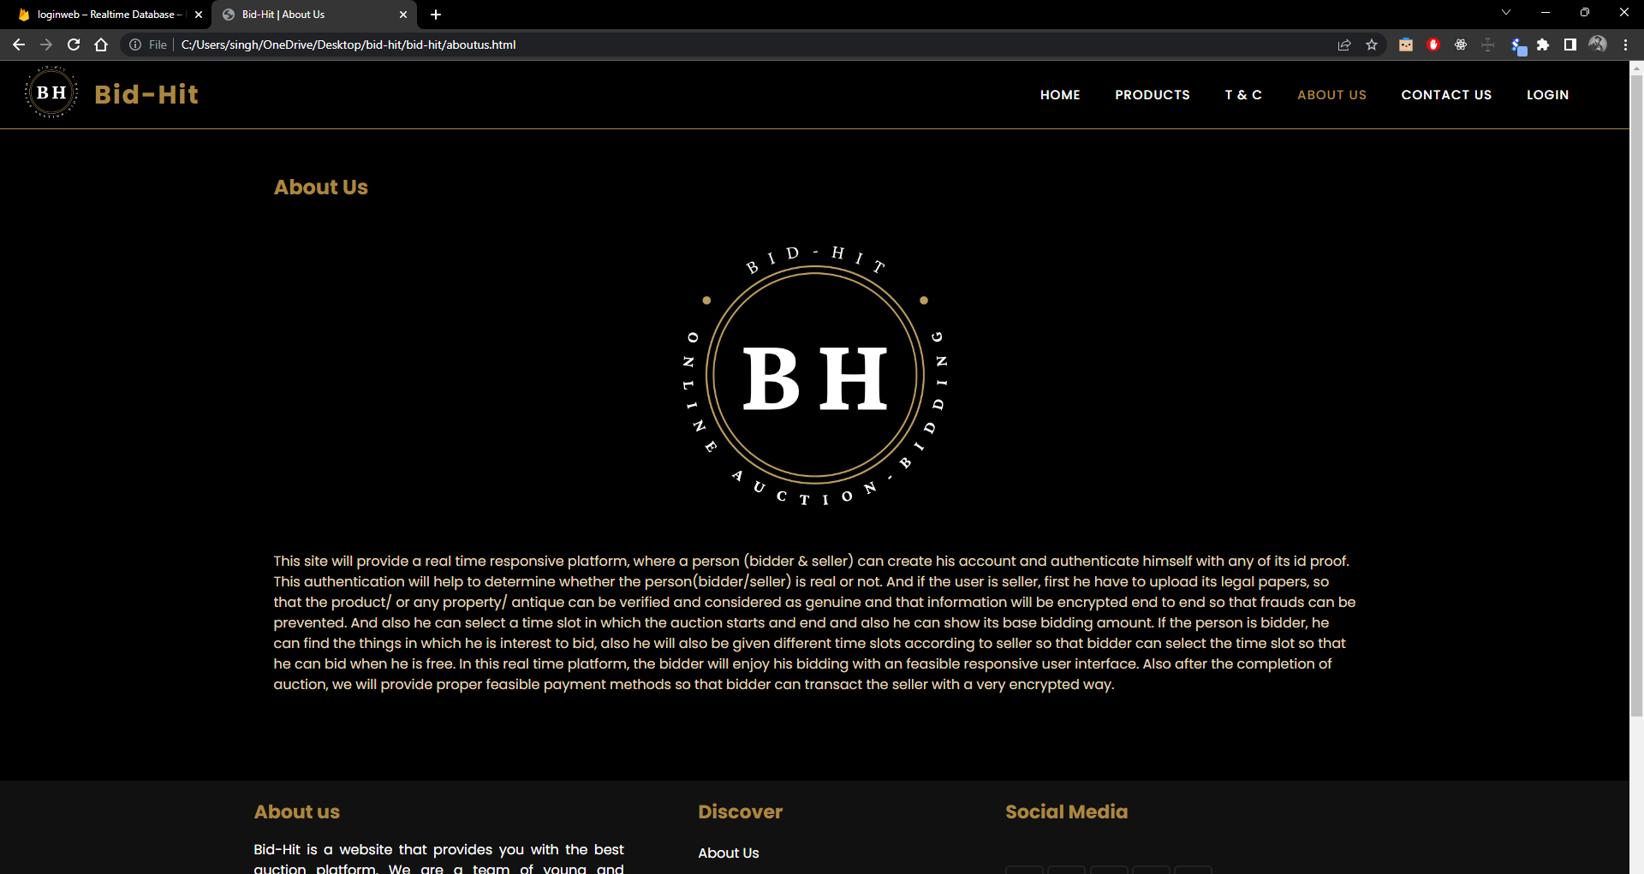

Slide 17
Contact Us Page
Here the user can contact to us, through his/her email address.
And his/her query will get into the firebase.

Slide 18
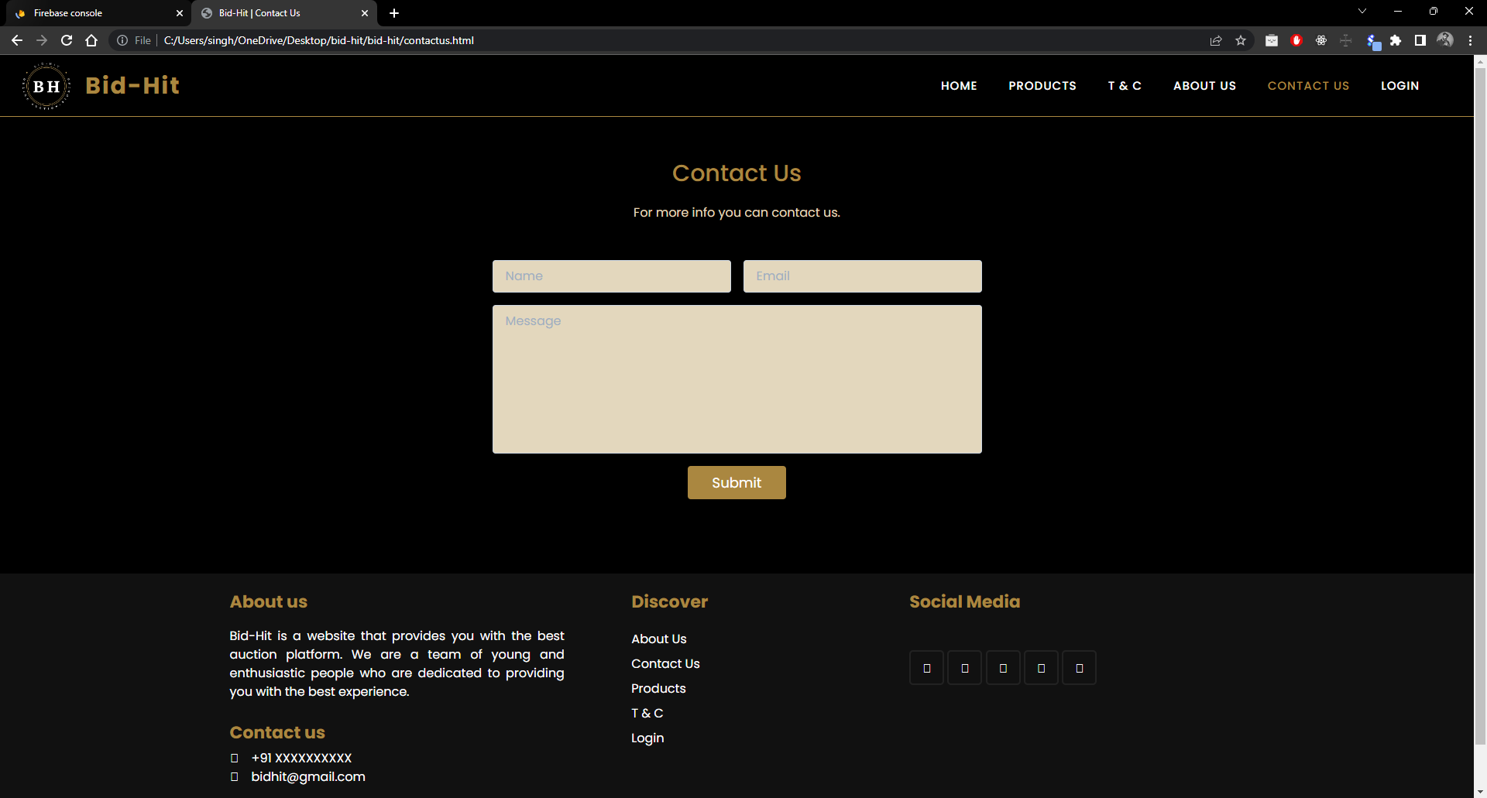

Slide 19
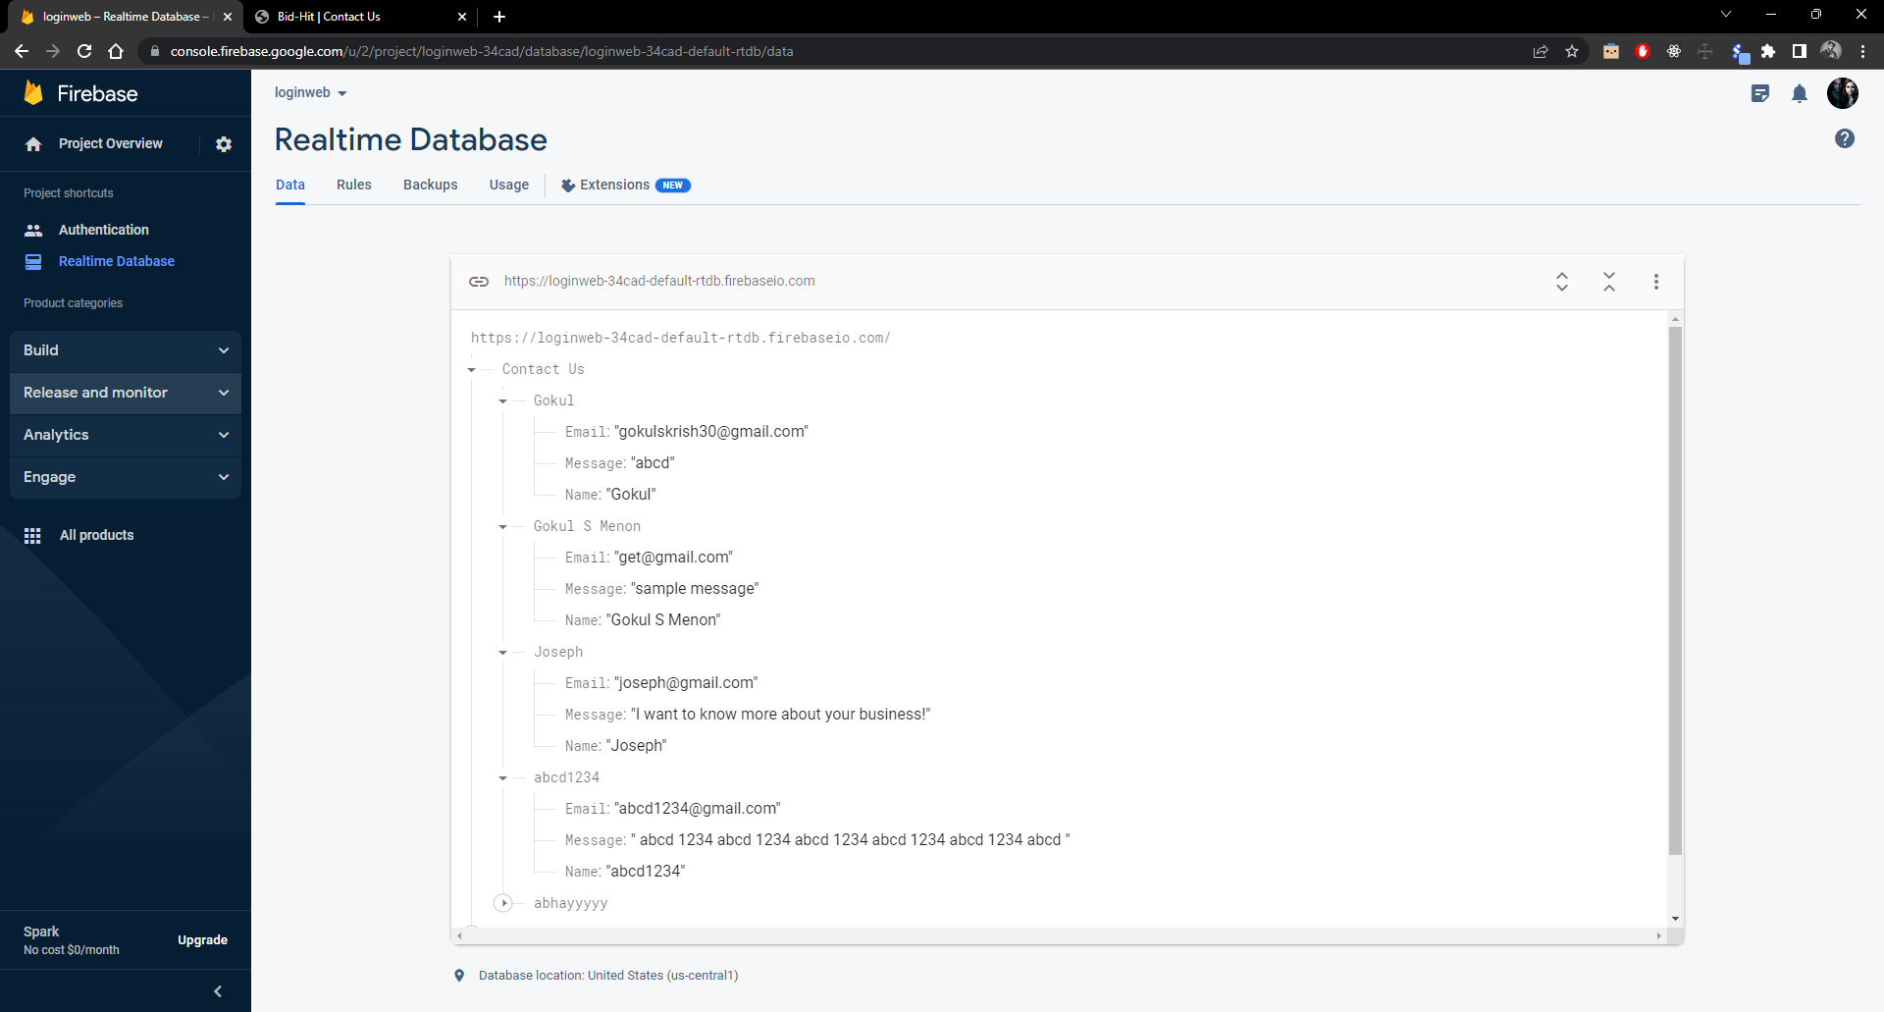

Slide 20
Products Page
Here, the user can see get some of the antiques and can bid on any of the antique of his choice.
But the he can only bid, if the bidding time has been started, if the bidding time is not started, the user can not bid.

Slide 21
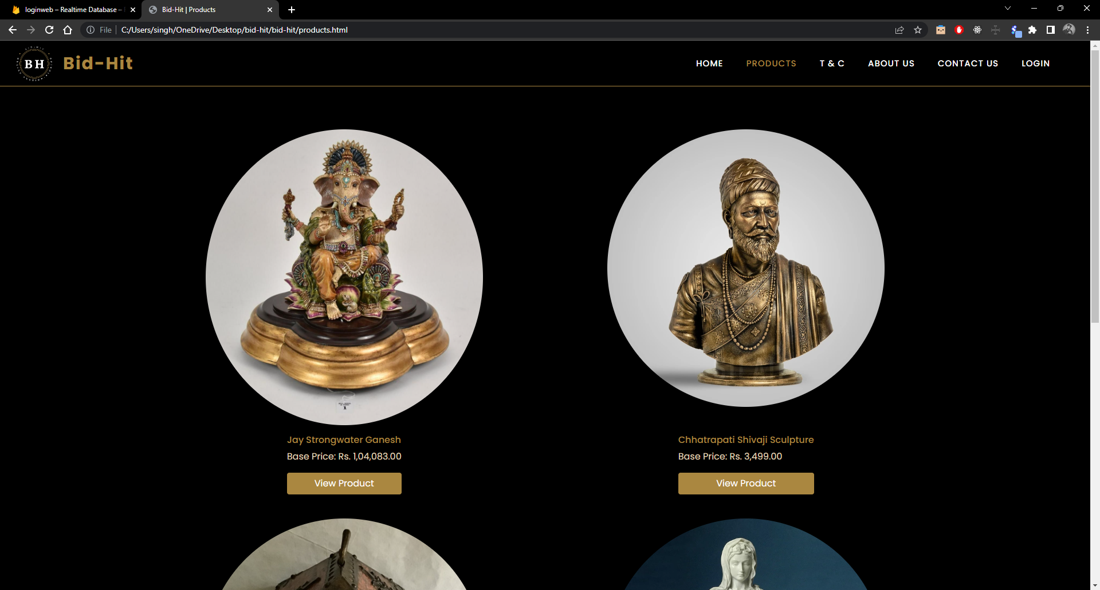

Slide 22
If Bidding is closed -
If the bidding is closed, the user will receive a pop-up(bidding is closed).
Then the user must have to wait till the opening time of the bidding, till that he cannot bid, as the ‘bid now’ button will remain disable.

Slide 23
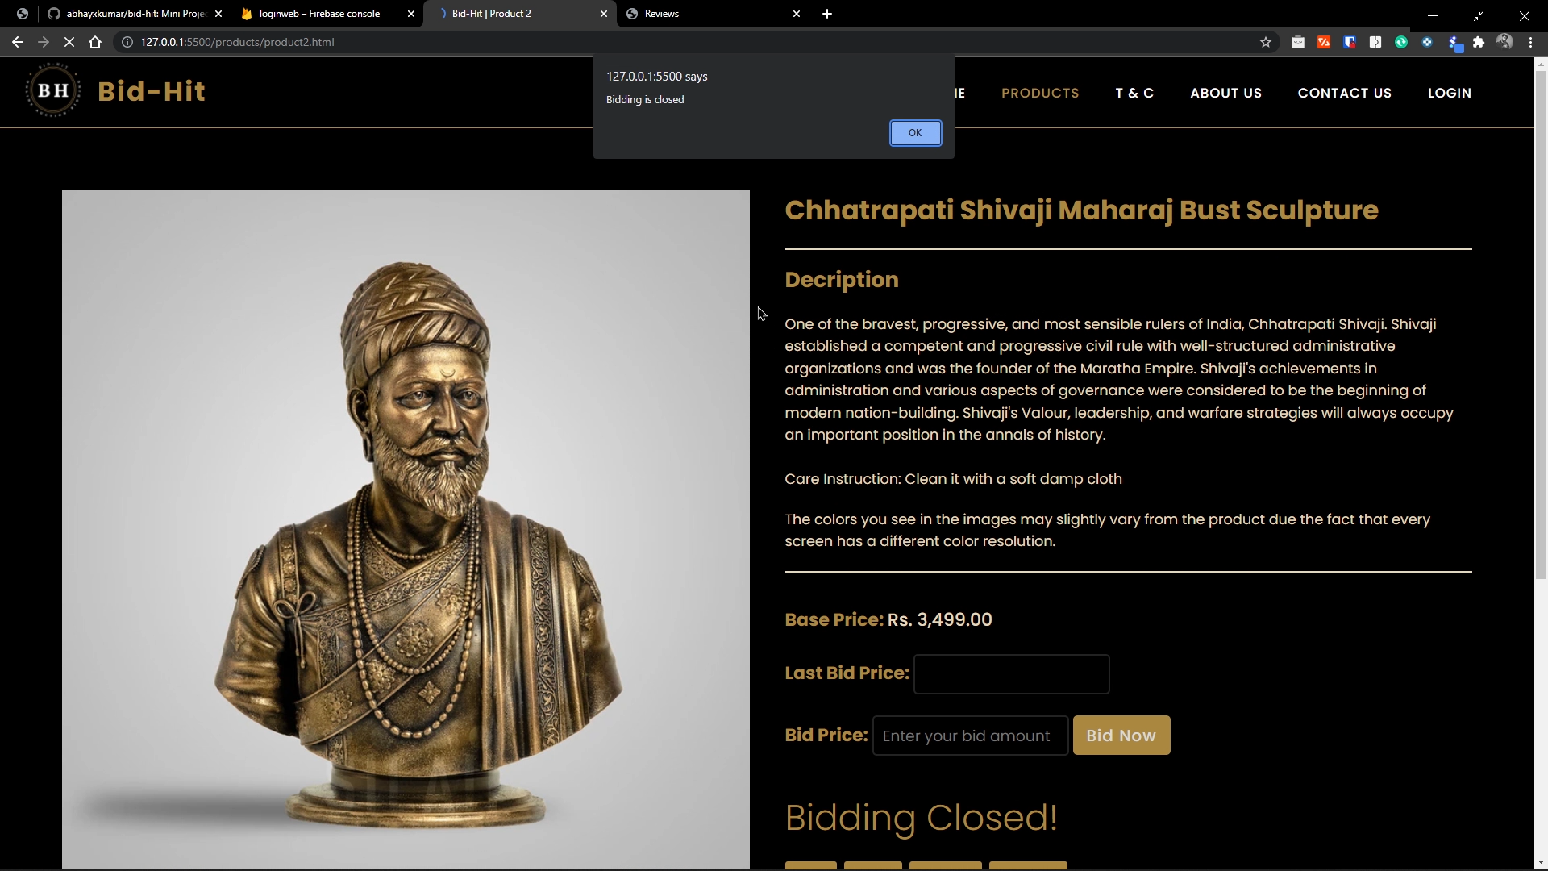

Slide 24
If Bidding is open -
If the bidding is open, the user will receive a pop-up(bidding is open). Then the user can bid on that product as the ‘bid now’ will remain enable untill the bidding gets end.
During the opening time the user can bid by entering his amount, if the amout entered will be greater than the last bid price, the bid price will be updated.
After the successfull completion of bidding, the bid now button will get disable and the payment option will come where user can pay the bidding amount.

Slide 25
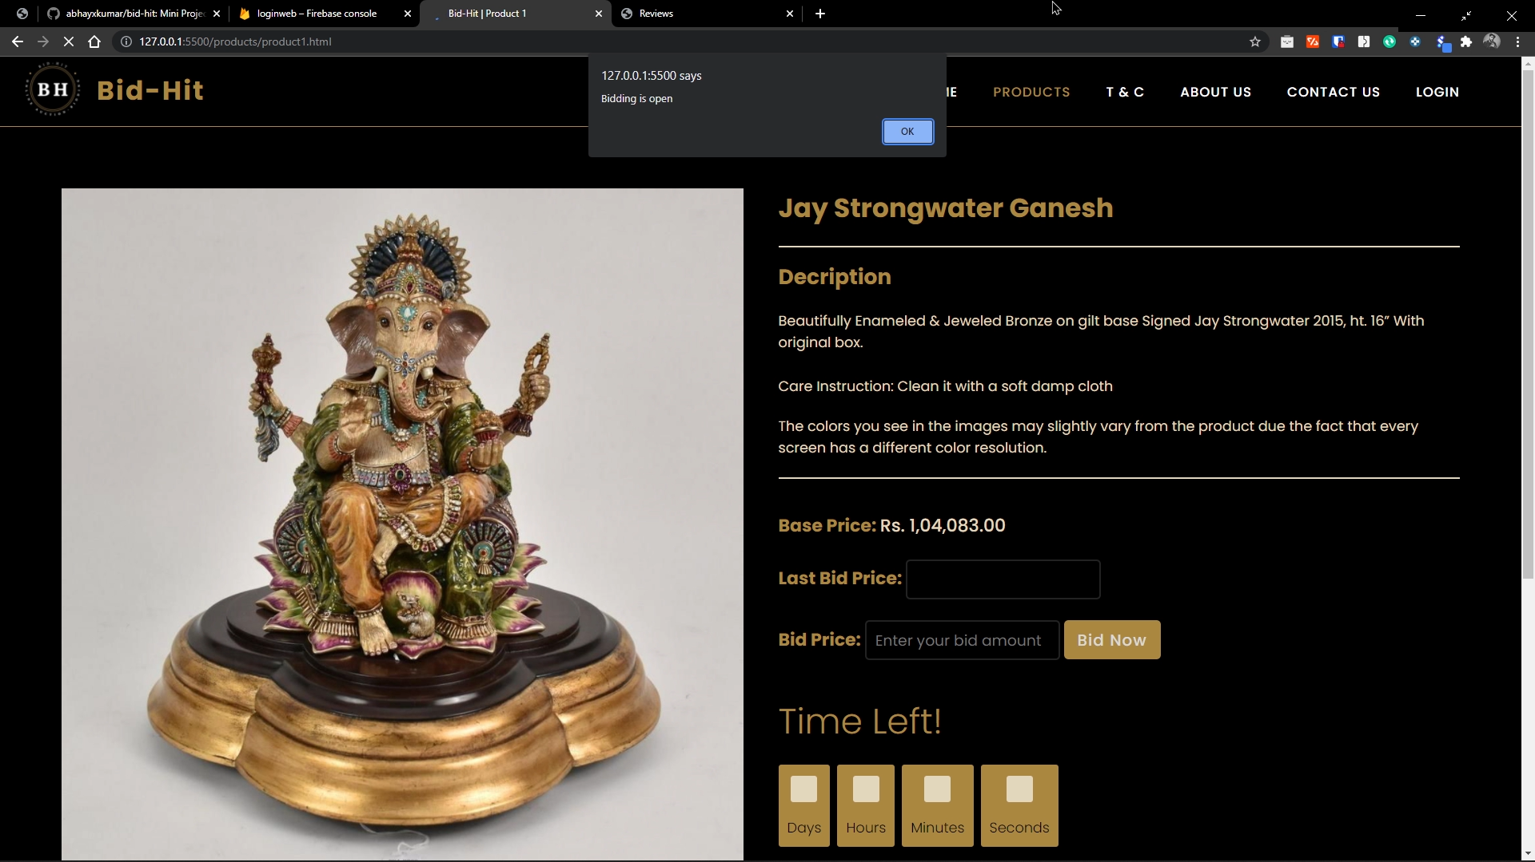

Slide 26
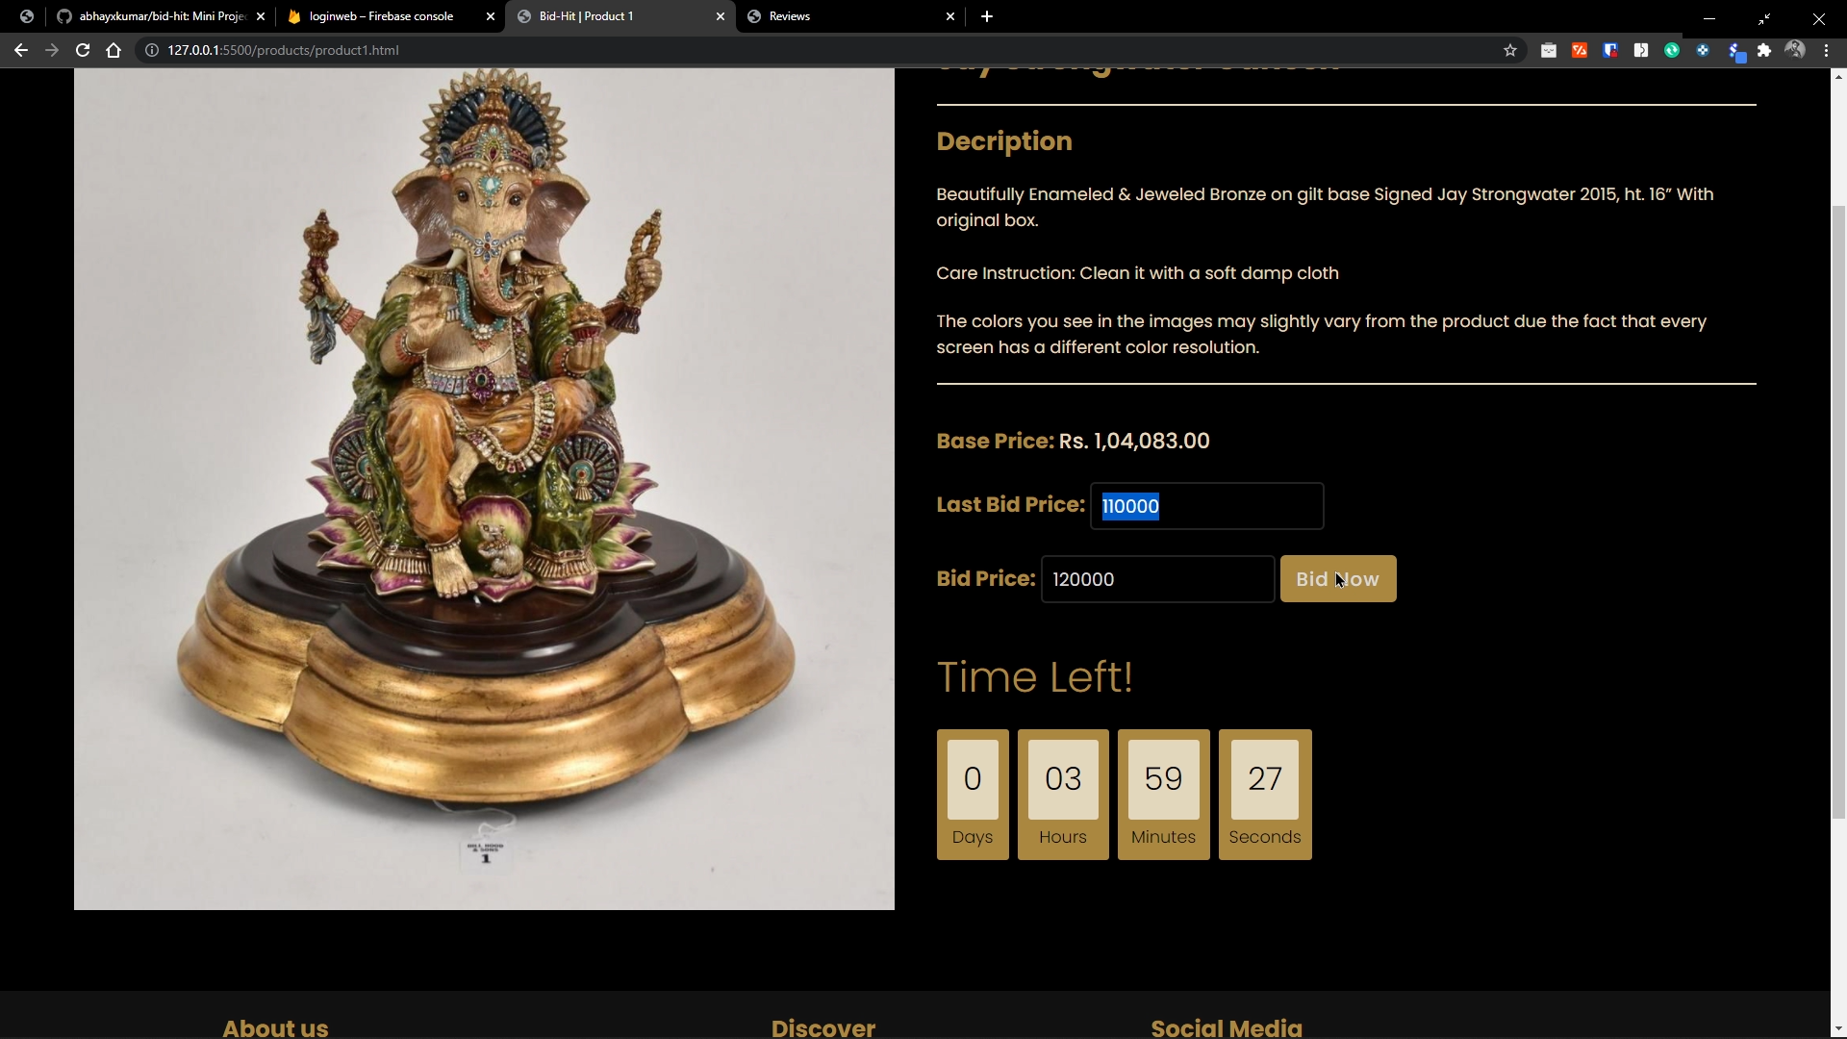

Slide 27


Slide 28
Thank You!

